Slide 1
MINI PROJECT 3 : CLUSTERING Business Goal : To create Customer cluster to identify the different types of customers
MAITRI NARANG DSFT 8

Slide 2
About Data :
The data contains 200 records with no null values.
The data is symmetrical, no skewness exists.

Slide 3
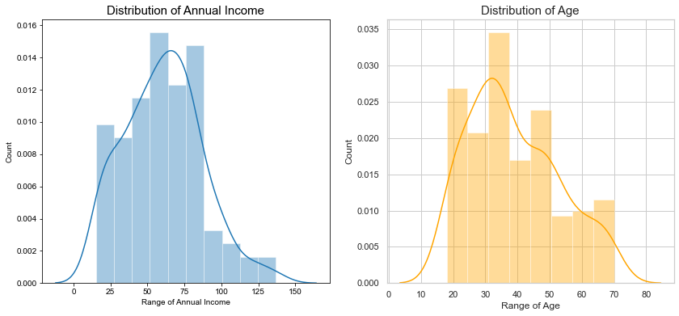
There are few people who earn more than 100 US Dollars. Most of the people have earning of around 50-75 US Dollars. Also, we can say that the least Income is around 20 US Dollars. Taking inferences about the Customers.
The most regular customers for the Mall has age around 30-35 years of age. Whereas the senior citizens age group is the least frequent visitor in the Mall.

Slide 4
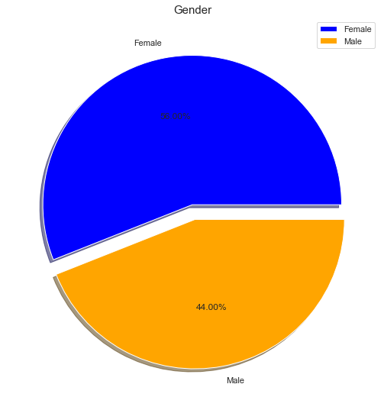
Interestingly, The Females are in the lead with a share of 56% whereas the Males have a share of 44%, that's a huge gap specially when the population of Males is comparatively higher than Females.

Slide 5
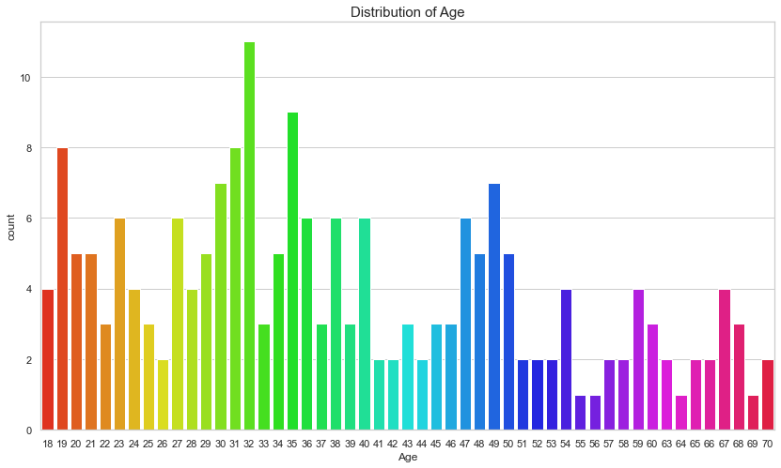
Interesting Fact, There are equal no. of Visitors in the Mall for the Agee 18 and 67. People of Age 55, 56, 69, 64 are very less frequent in the Malls. People at Age 32 are the Most Frequent Visitors in the Mall.

Slide 6
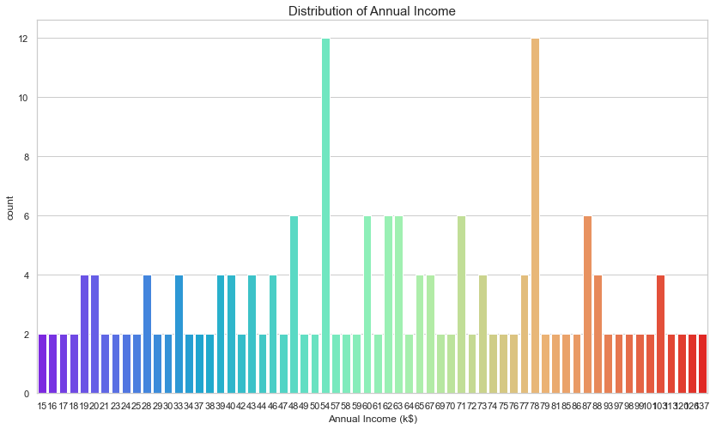
There are more Customers in the Mall who have their Annual Income as 54k US Dollars or 78 US Dollars.

Slide 7
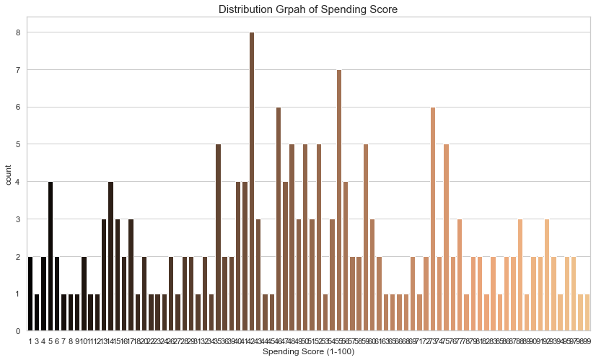
On a general level, we may conclude that most of the Customers have their Spending Score in the range of 35-60. Interesting there are customers having spending score also, and 99 Spending score also, Which shows that the mall caters to the variety of Customers with varying needs and requirements available in the Mall.

Slide 8
CONCLUSIONS:
Most of the people have earning of around 50-75 US Dollars.
The Females are in the lead with a share of 56% whereas the Males have a share of 44%.
People at Age 32 are the Most Frequent Visitors in the Mall.
There are more Customers in the Mall who have their Annual Income as 54k US Dollars or 78 US Dollars.
There are more number of males who get paid more than females.
The number of males and females are equal in number when it comes to low annual income.

Slide 9
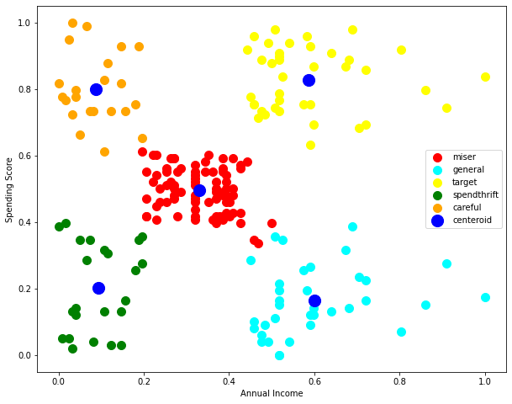
The finalized model to predict the grade of house is KMeans which shows an accurate performance with minimum errors . There are clearly Five segments of Customers namely Miser, General, Target, Spendthrift, Careful based on their Annual Income and Spending Score which are reportedly the best factors/attributes to determine the segments of a customer in a Mall. Here, our TARGET customers are the ones who have a medium-high annual income and a high spending score.

Slide 10
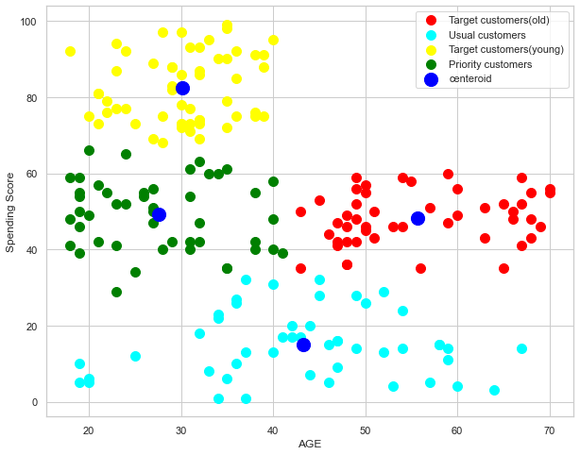
According to AGE : Aggregated into 4 different categories namely Usual Customers, Priority Customers, Senior Citizen Target Customers, Young Target Customers. Thus, we can accordingly make different marketing strategies and policies to optimize the spending scores of the customer in the Mall.
Here, our TARGET customers are the young aged customers who have high spending scores. And old aged customers which high spending scores.

Slide 11
THANKYOU

